Slide 1
Topic: Place Value
EQ – How to estimate using lead digit rounding?

Slide 2
What Goes In The Box ?
Round the following to the nearest whole number:
NB: always round 0.5 up . I.e. 12.5 ≈ 13 (to the nearest whole number).
(1) 4.8
5
(6) 287.6
288
(2) 7.4
7
(7) 9.8
10
(3) 44.6
45
(8) 49.6
50
(4) 87.5
88
(9) 99.7
100
(5) 56.3
56
(10) 399.5
400

Slide 3
Rounding To The Nearest 10
Round 467 to the nearest ten.
Which number is the tens number ?
6
Is the number after the 6 greater or smaller than 5 ?
7 > 5
Rule
If the number is greater than or equal to 5 then round up.
Now round 467 to the nearest ten.
467 ≈ 470 (to the nearest ten).
460
467
470

Slide 4
Round 23 438 to the nearest hundred.
Which number is the hundreds number ?
4
Is the number after the 4 greater or smaller than 5 ?
3 < 5
Now round 23 438 to the nearest hundred.
Rule
If the number is greater than or equal to 5 then round up.
23 438= 23 400 (to the nearest hundred).
23 400
23 500
23 438

Slide 5
What Goes In The Box ? 2
Round the numbers below to the required unit:
(1) 67 to the nearest ten =
70
(2) 943 to the nearest hundred =
900
(3) 518 to the nearest ten =
520
(4) 5 218 to the nearest hundred =
5 200

Slide 6
24
7
30
Date
Place Value
EQ – How to estimate using lead digit rounding?
How do we estimate?
It is not always possible or convenient to work out or give exact answer to a problem.
It is not a guess, but a quick approximation of an answer.
Method : Round to the first digit and carry out the operation.
≈ symbol is used to indicate approximation
7

Slide 7
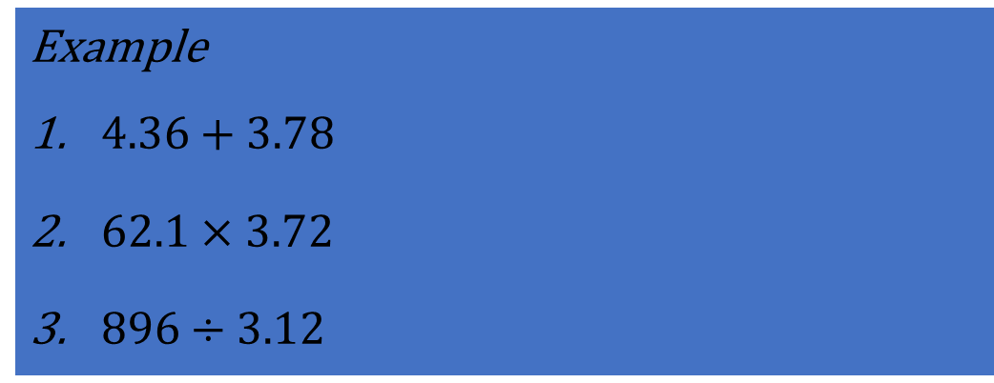
24
7
30
Date
Place Value
EQ – How to estimate using lead digit rounding?
How do we estimate?
It is not always possible or convenient to work out or give exact answer to a problem.
It is not a guess, but a quick approximation of an answer.
Method : Round to the first digit and carry out the operation.
≈ symbol is used to indicate approximation
Example
$4.36+3.78$
$62.1×3.72$
$896÷3.12$
7

Slide 8
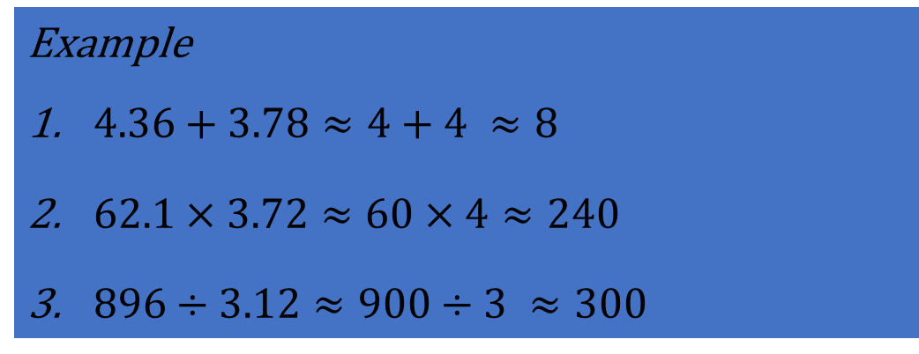
24
7
30
Date
Place Value
EQ – How to estimate using lead digit rounding?
How do we estimate?
It is not always possible or convenient to work out or give exact answer to a problem.
It is not a guess, but a quick approximation of an answer.
Method : Round to the first digit and carry out the operation.
≈ symbol is used to indicate approximation
Example
$4.36+3.78≈4+4 ≈8$
$62.1×3.72≈60×4≈240$
$896÷3.12≈900÷3 ≈300$
7

Slide 9
Tasks

Slide 10


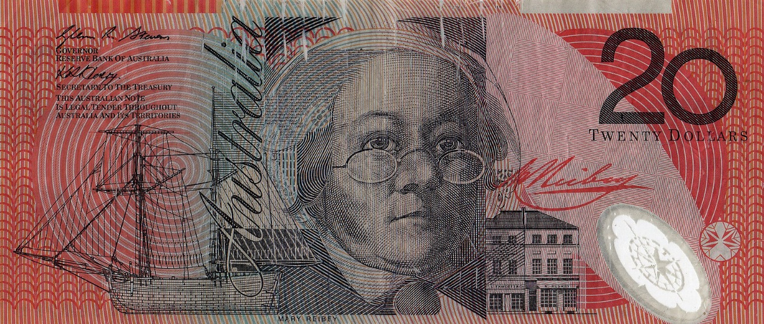
I'm gonna pop some tags
Only got twenty dollars in my pocket
2 x Milk (2L)
1 x Nutella 750 g
2 x Avocado
1 x Marshmallows Bag
Can I buy the products in the shopping list with $20?
Product | Cost
Milk (2 L) | $1.99
Nutella (750 g) | $6.75
Avocado | $3.20
Marshmallows | $2.80

Slide 11
Summary

